Slide 1
CollabrifyGLY

Slide 2
Spec specified that undo/redo should transmit to the cloud, and then changes should be applied on receiving the undo/redo command.
We applied the changes immediately so the user can see a response time that is much shorter than otherwise.

Slide 3
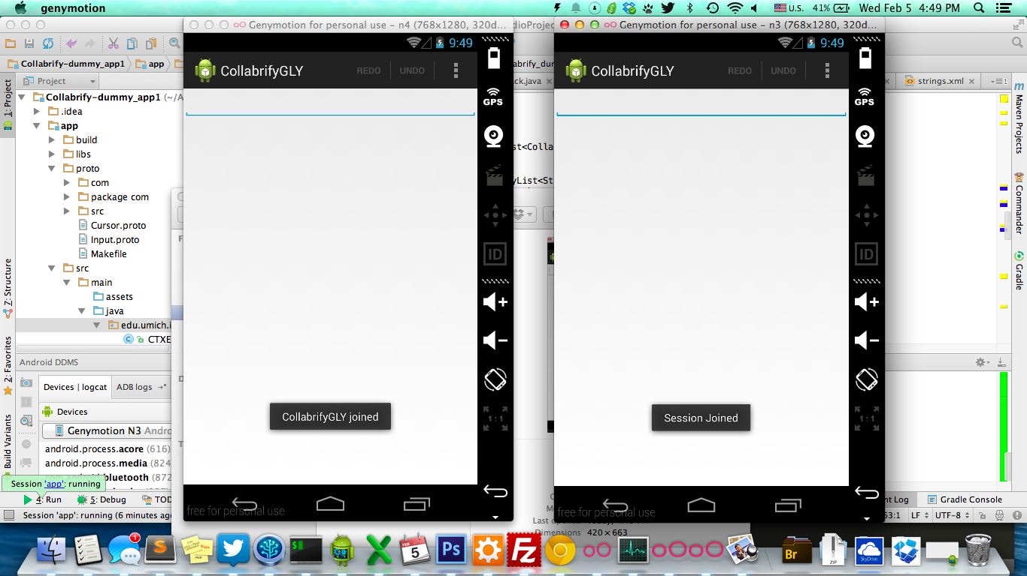

Slide 4
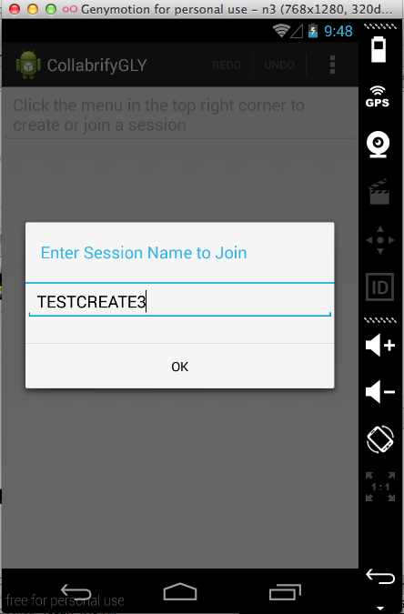

Slide 5
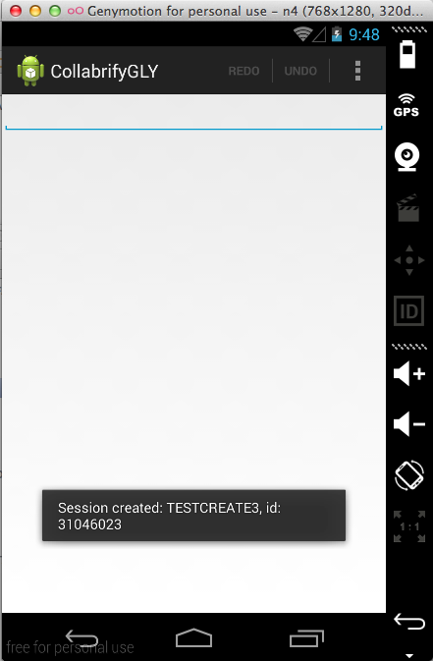

Slide 6
